Slide 1





Café Fiscal
Key Notes
Provided by the LAUSD Food Services Division
12.6.2024
Notes:
TELL: Welcome, Thank you for joining me today. My name is _______________ .

Slide 2


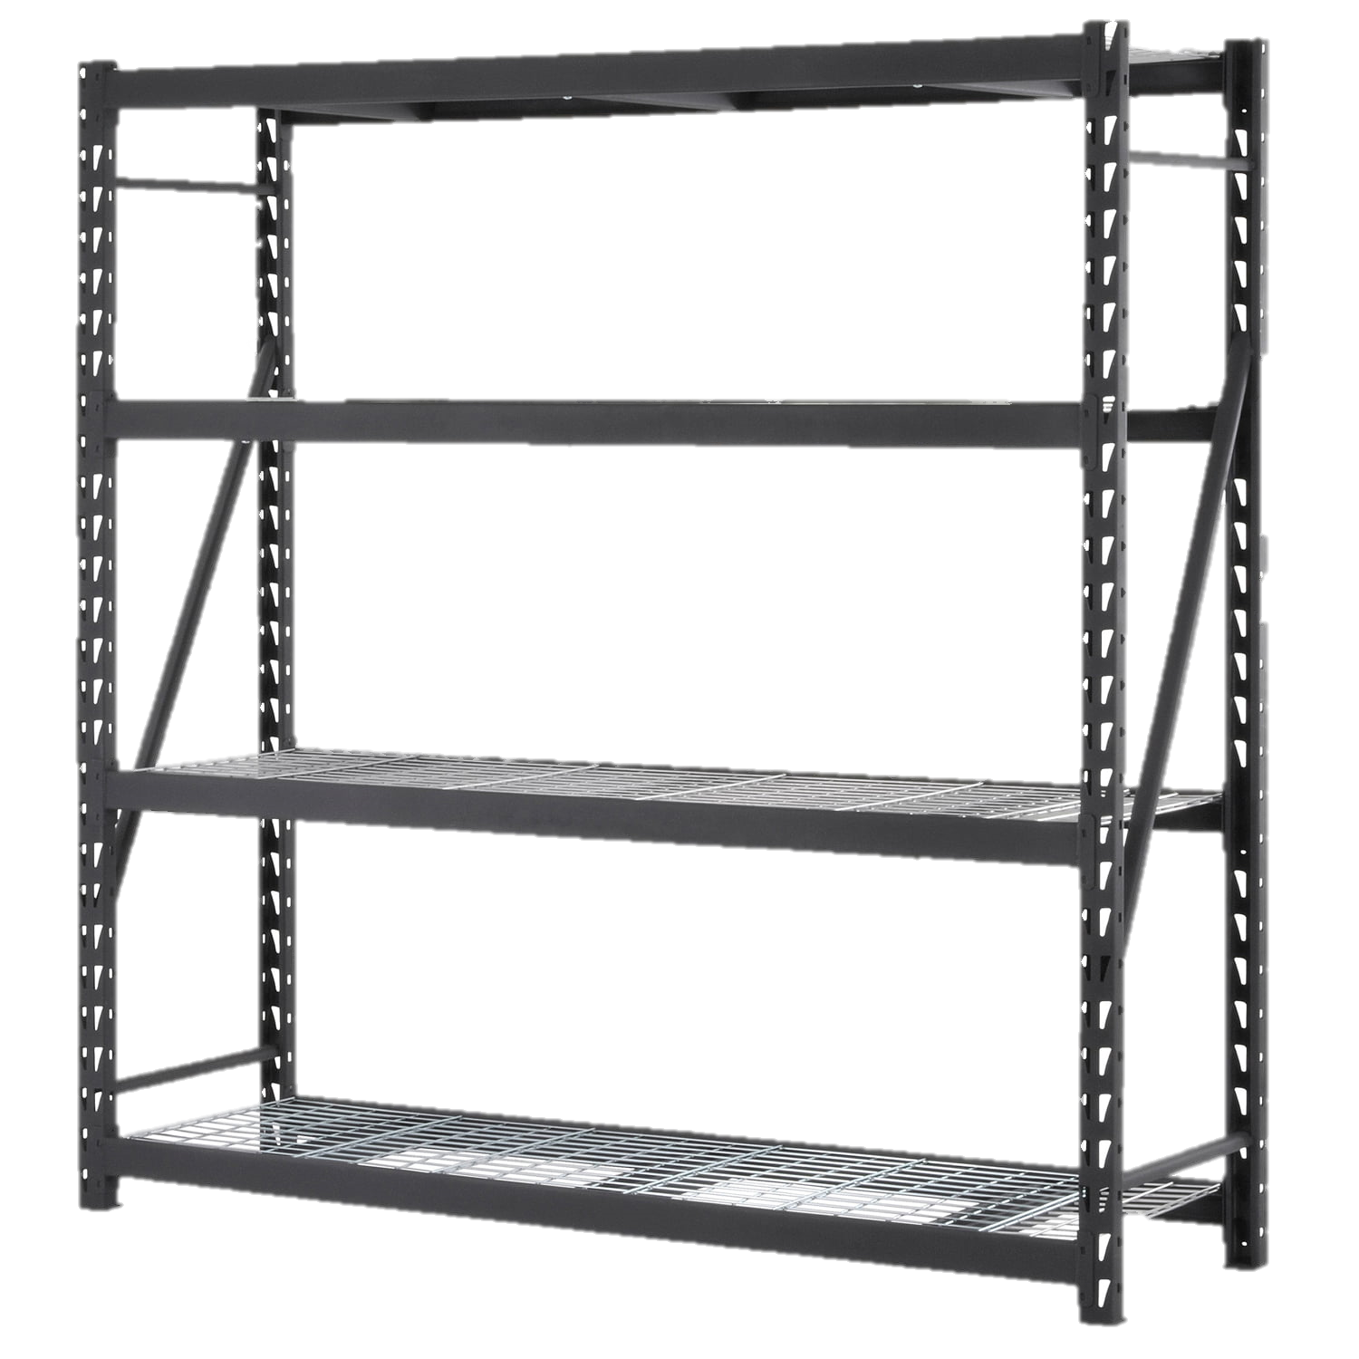
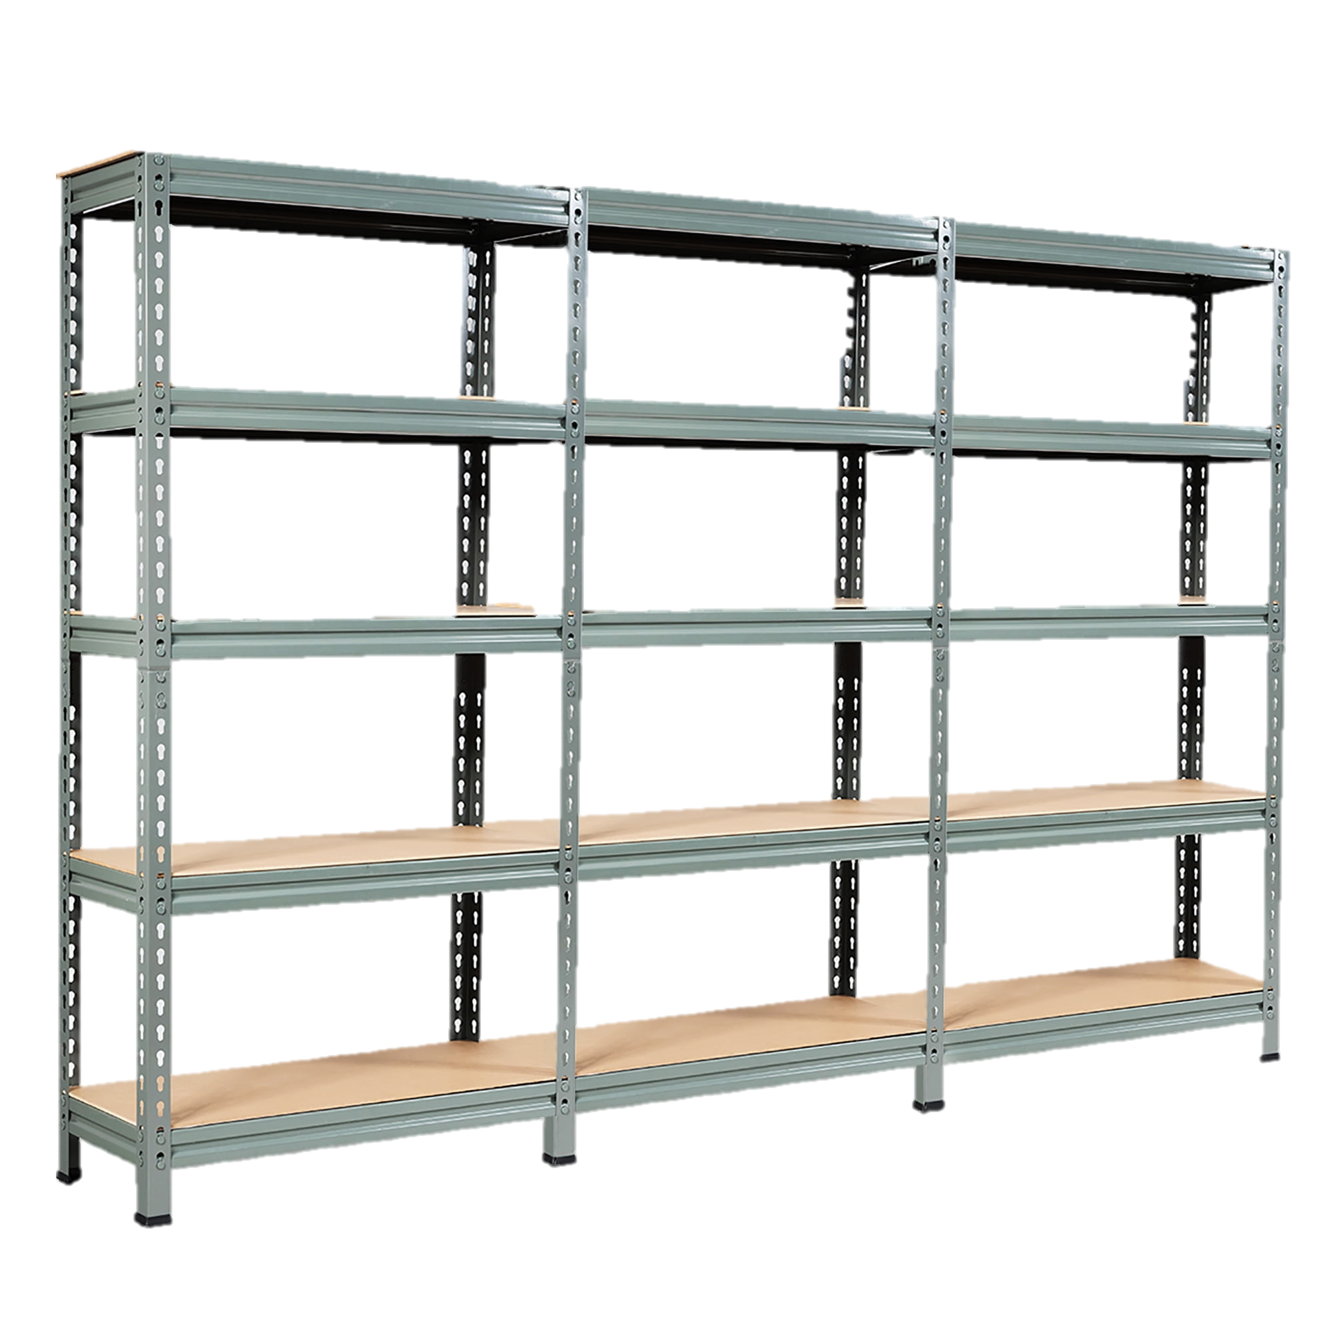


Overview
  Café Fiscal has provided a list of key areas in which errors have occurred. Managers should ensure all procedures are followed according to division SOP’s. We will discuss the following key areas:
  Meal counts
  Receivers and invoices
  Cash and sales transactions
  Invoices and cost forms
  Change fund
  Attendance/enrollment variances

Slide 3

Café Fiscal Contact Information
Special Function cafeteria invoices:
  Sandra Joya – sandra.joya@lausd.net
Direct delivery invoices and vendor payments
  Melissa Regalado – melissa.regalado@lausd.net
Cash deposits and Bank Reconciliation
  Allis Wong – allis.wong@lausd.net
Meal Counts
  Henry Cheah – henry.cheah@lausd.net
Other Café Fiscal matters
  Brenda Li – hong.li@lausd.net
  Michael Villaroman –michael.villaroman@lausd.net

Slide 4

Meal Counts

Slide 5
Quantity Sales
  When a quantity sale is necessary, the manager must identify the correct eligibility for each student served and enter a quantity sale for each eligibility category.
    Pricing schools do not enter all meals into the “Free” category, always enter meals by their eligibility: free, reduced or full pay
    CEP schools enter all meals into the “Free” category

Slide 6
CSPP And Offsite Schools
  California State Preschool Program (CSPP) and Offsite schools that are pricing must enter meal and enrollment counts by eligibility.
    Complete CMS “Daily Entry” every day
      Use the attendance tab to input enrollment, enter by approved free and reduced eligibilities boxes
    Communicate with Meal Compliance to obtain each students eligibility
  California State Preschool Program (CSPP) and Offsite schools that are CEP must enter meal and enrollment counts by eligibility into the “Free” category.

Slide 7
Meal Exceptions Report
  The Focus Dashboard, Meal Count Exceptions report shows details of items that need your attention such as:
    Missing meals
    Out of compliance
    Meal counts below average
When an error is discovered update the CMS meals count data immediately.

Slide 8
Meal Exceptions Report Instructions
  To obtain the Focus Dashboard, Meal Count Exceptions Report follow these steps:
    Go to Focus.lausd.net
    Select “Operations”
    Select “Food Services”
    Select “Café Meal Count and Revenue Summary view”
    Select dropdown filter box in the top right corner and click on “meal counts exceptions”
    Click “meal counts missing row” to see list of missing counts by program and by date
The report is updated each morning.

Slide 9
BIC Adult Meals
  Ensure BIC adult meals are entered as “Adult” meals.
    Do not use the student eligibility category
    Click on the dropdown box and change the “Free” to “Adult”
    Make sure that the “BIC Adult” button is pressed before entering the BIC adult meal count
    If no adult meals are claimed for the day the manager may be asked to verify that no adults received a meal

Slide 10
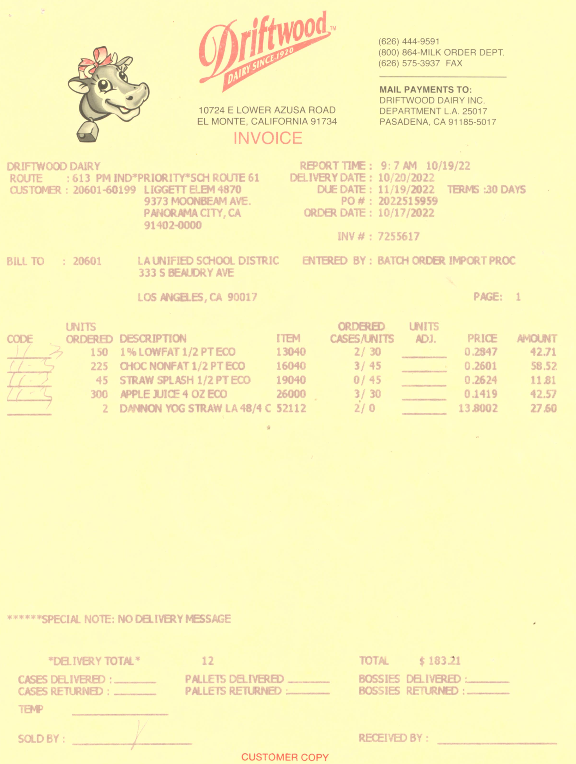

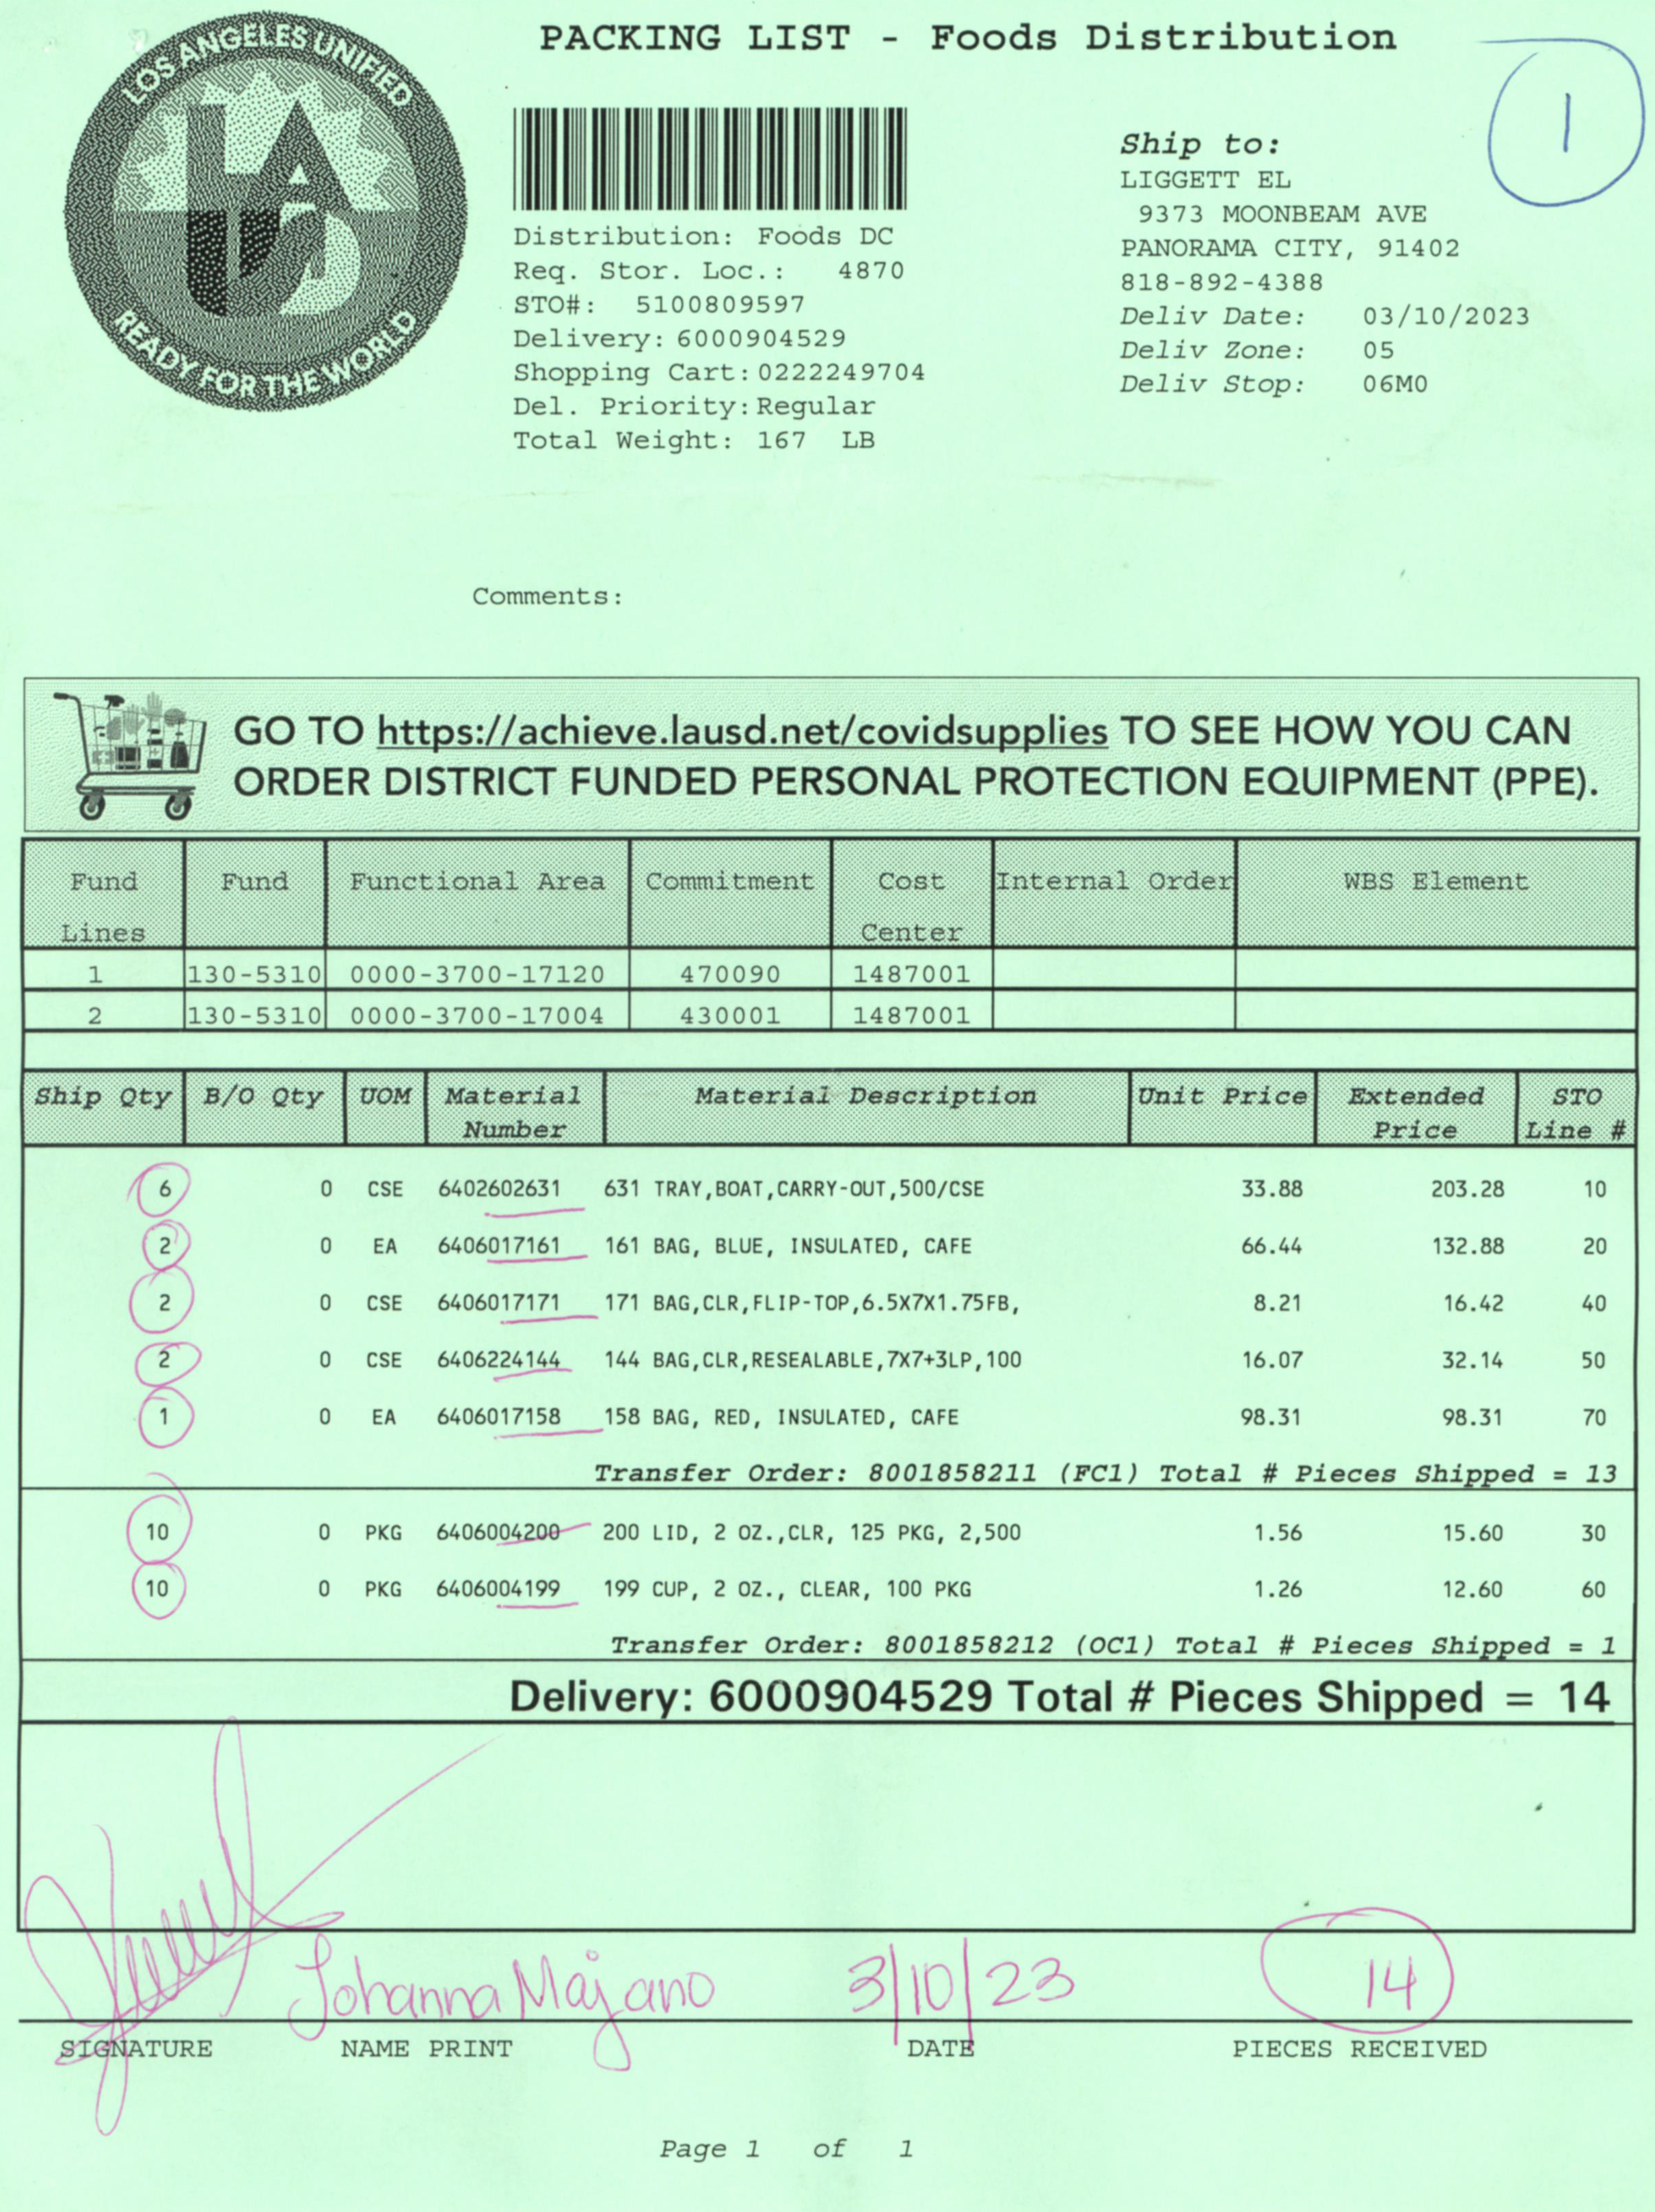
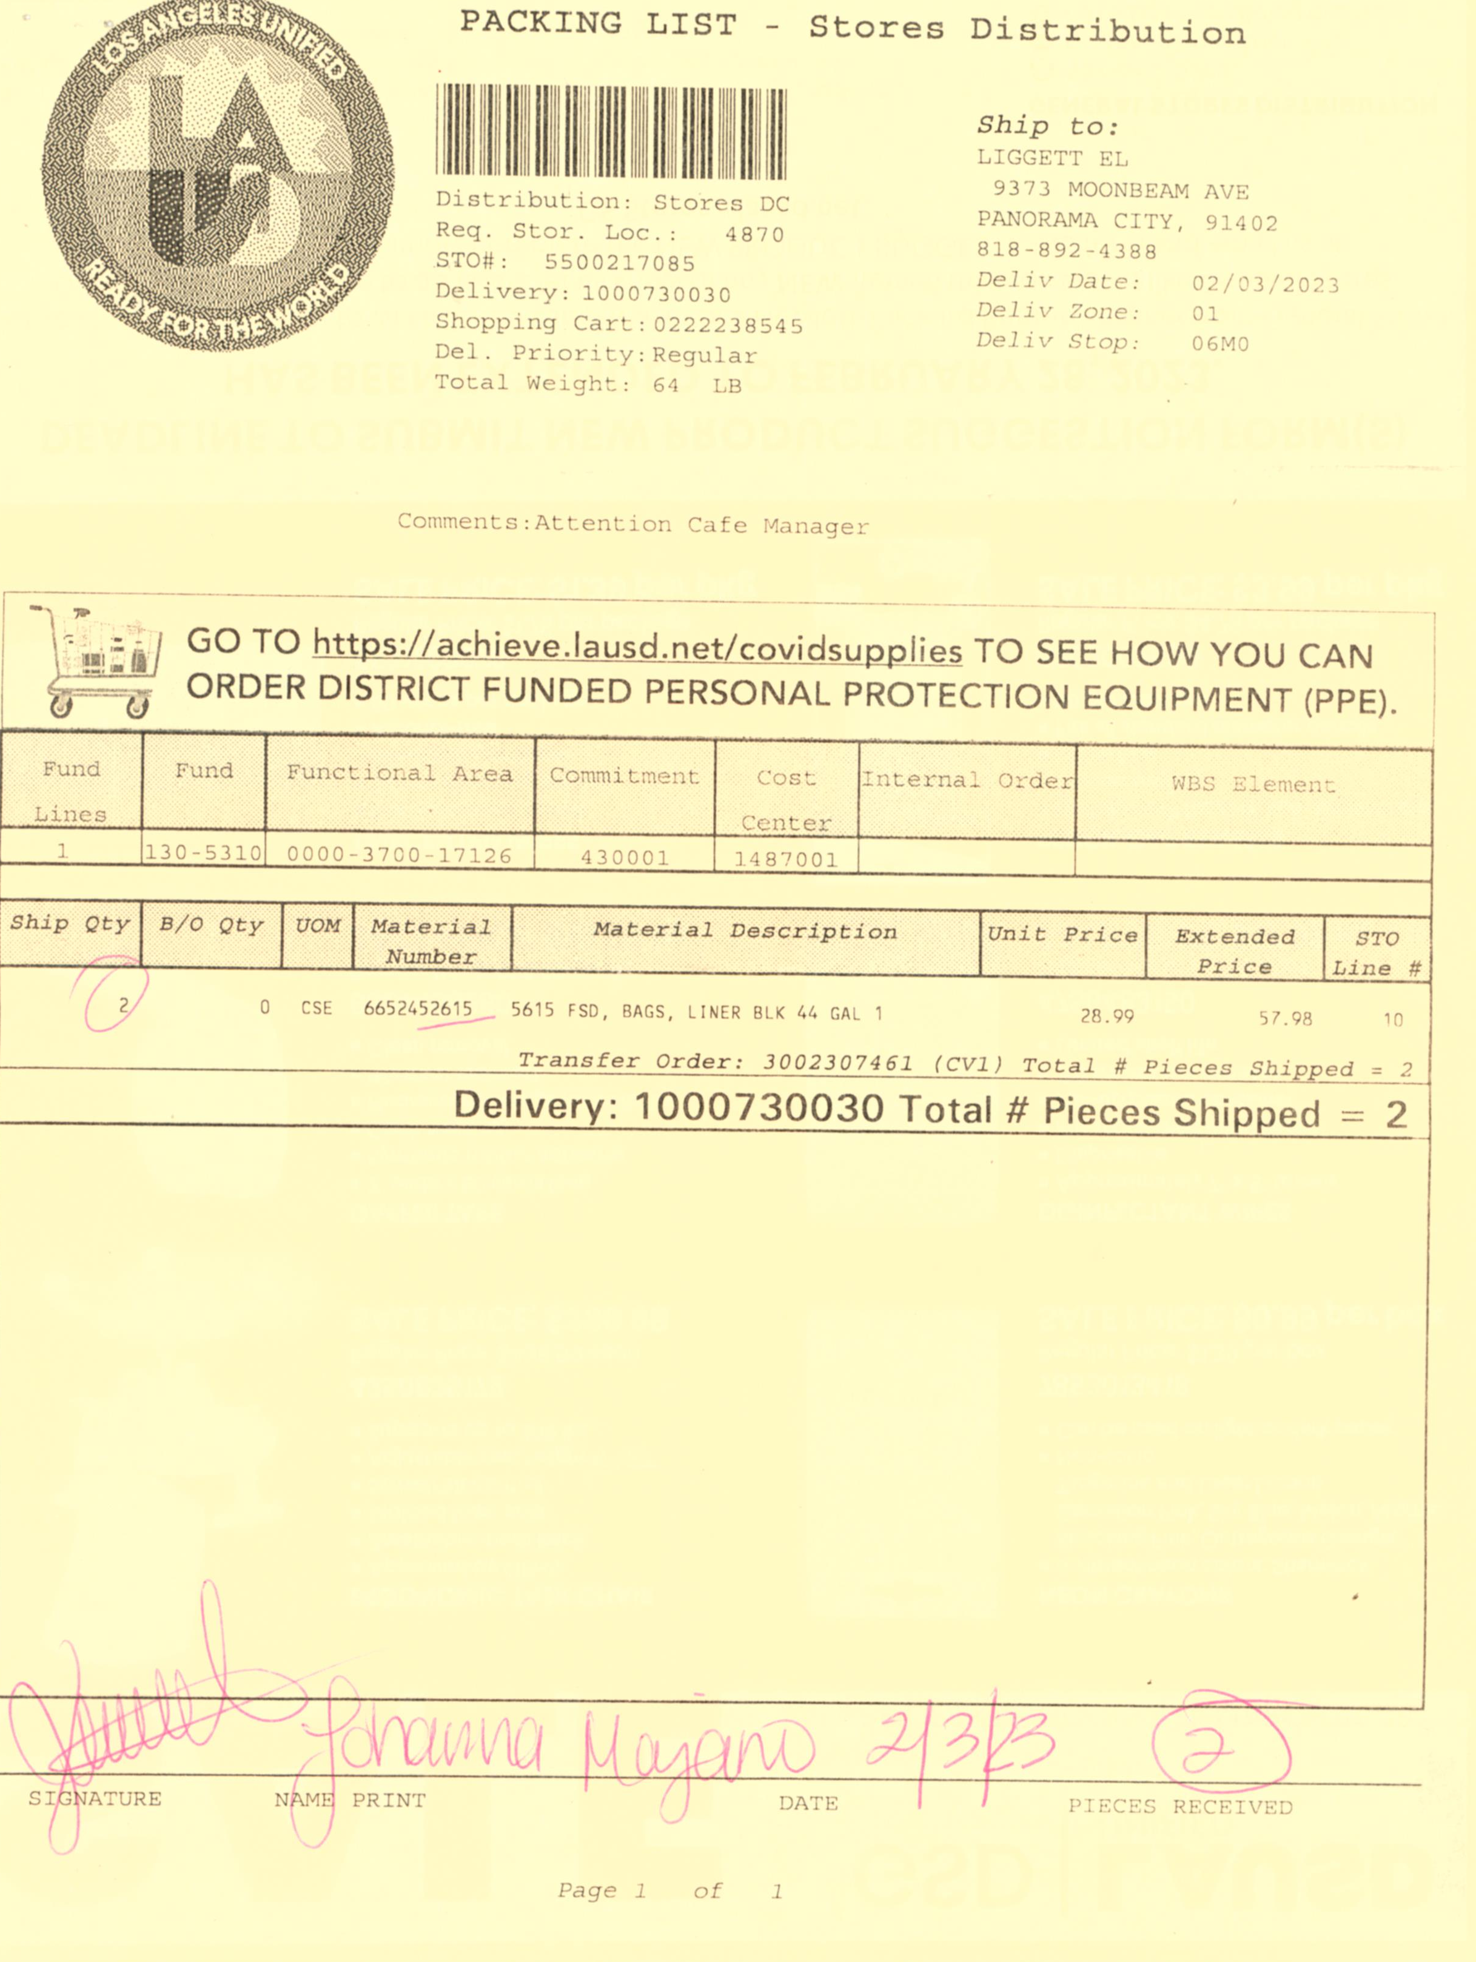
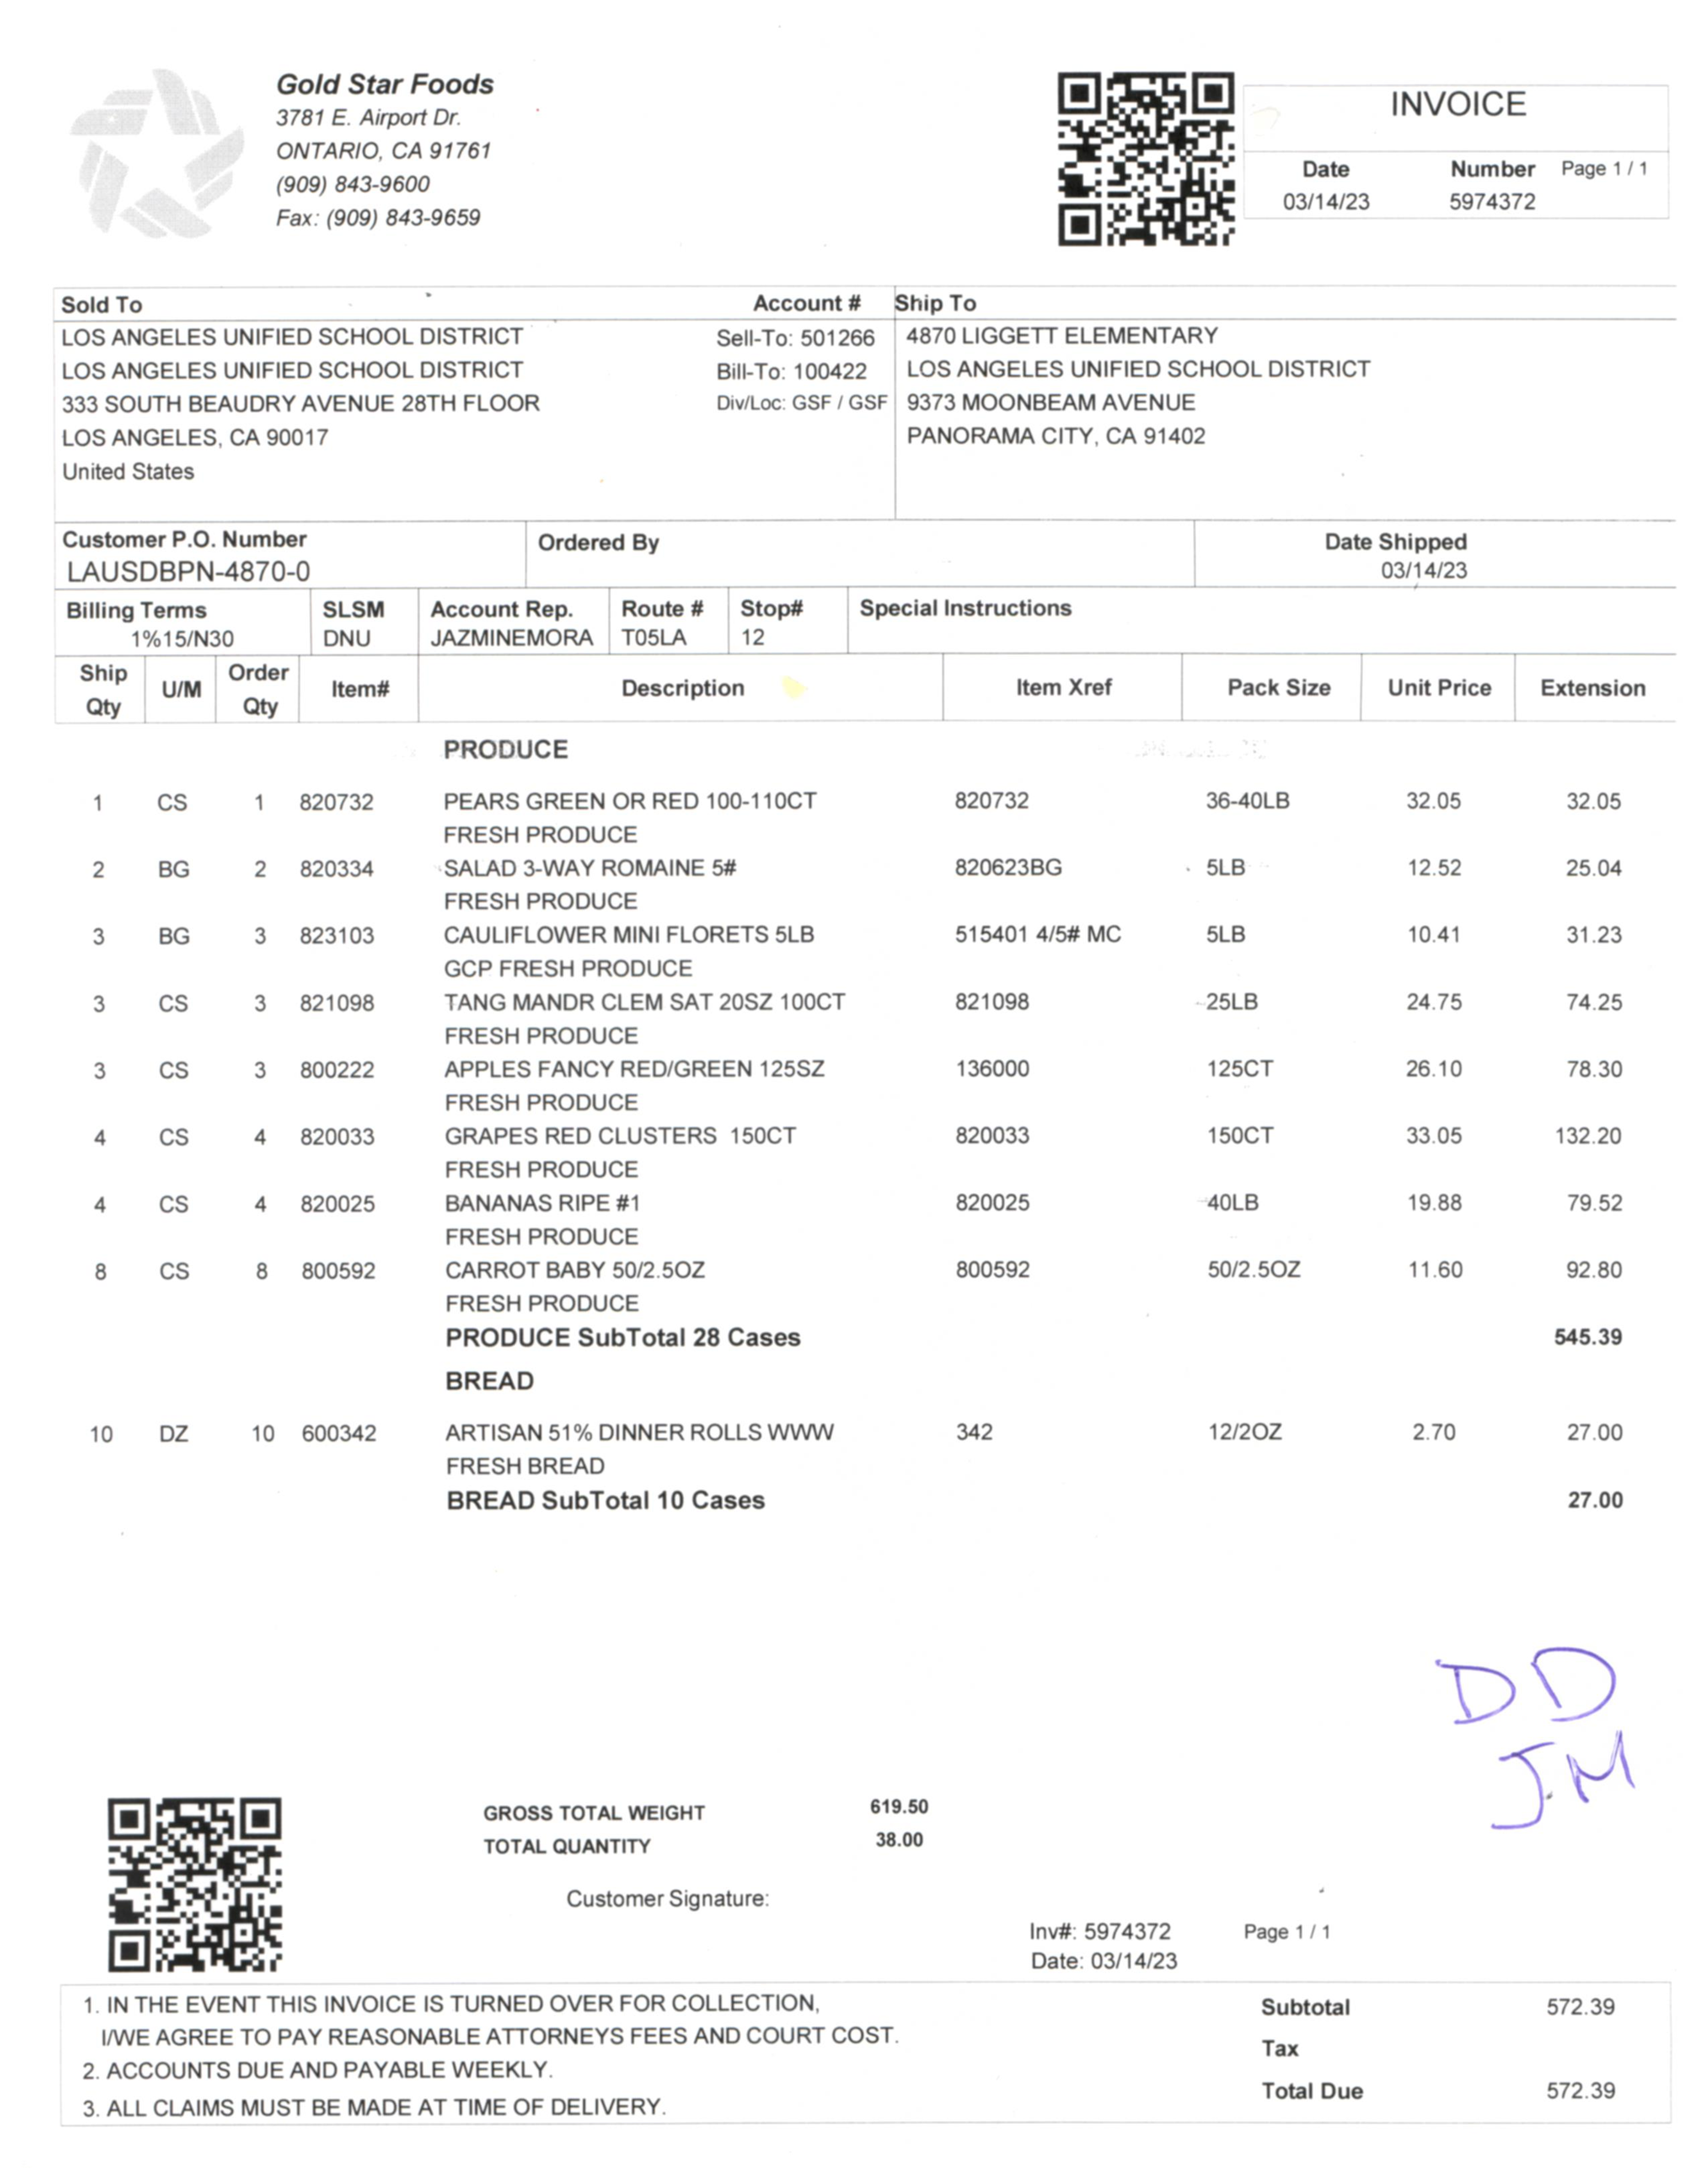
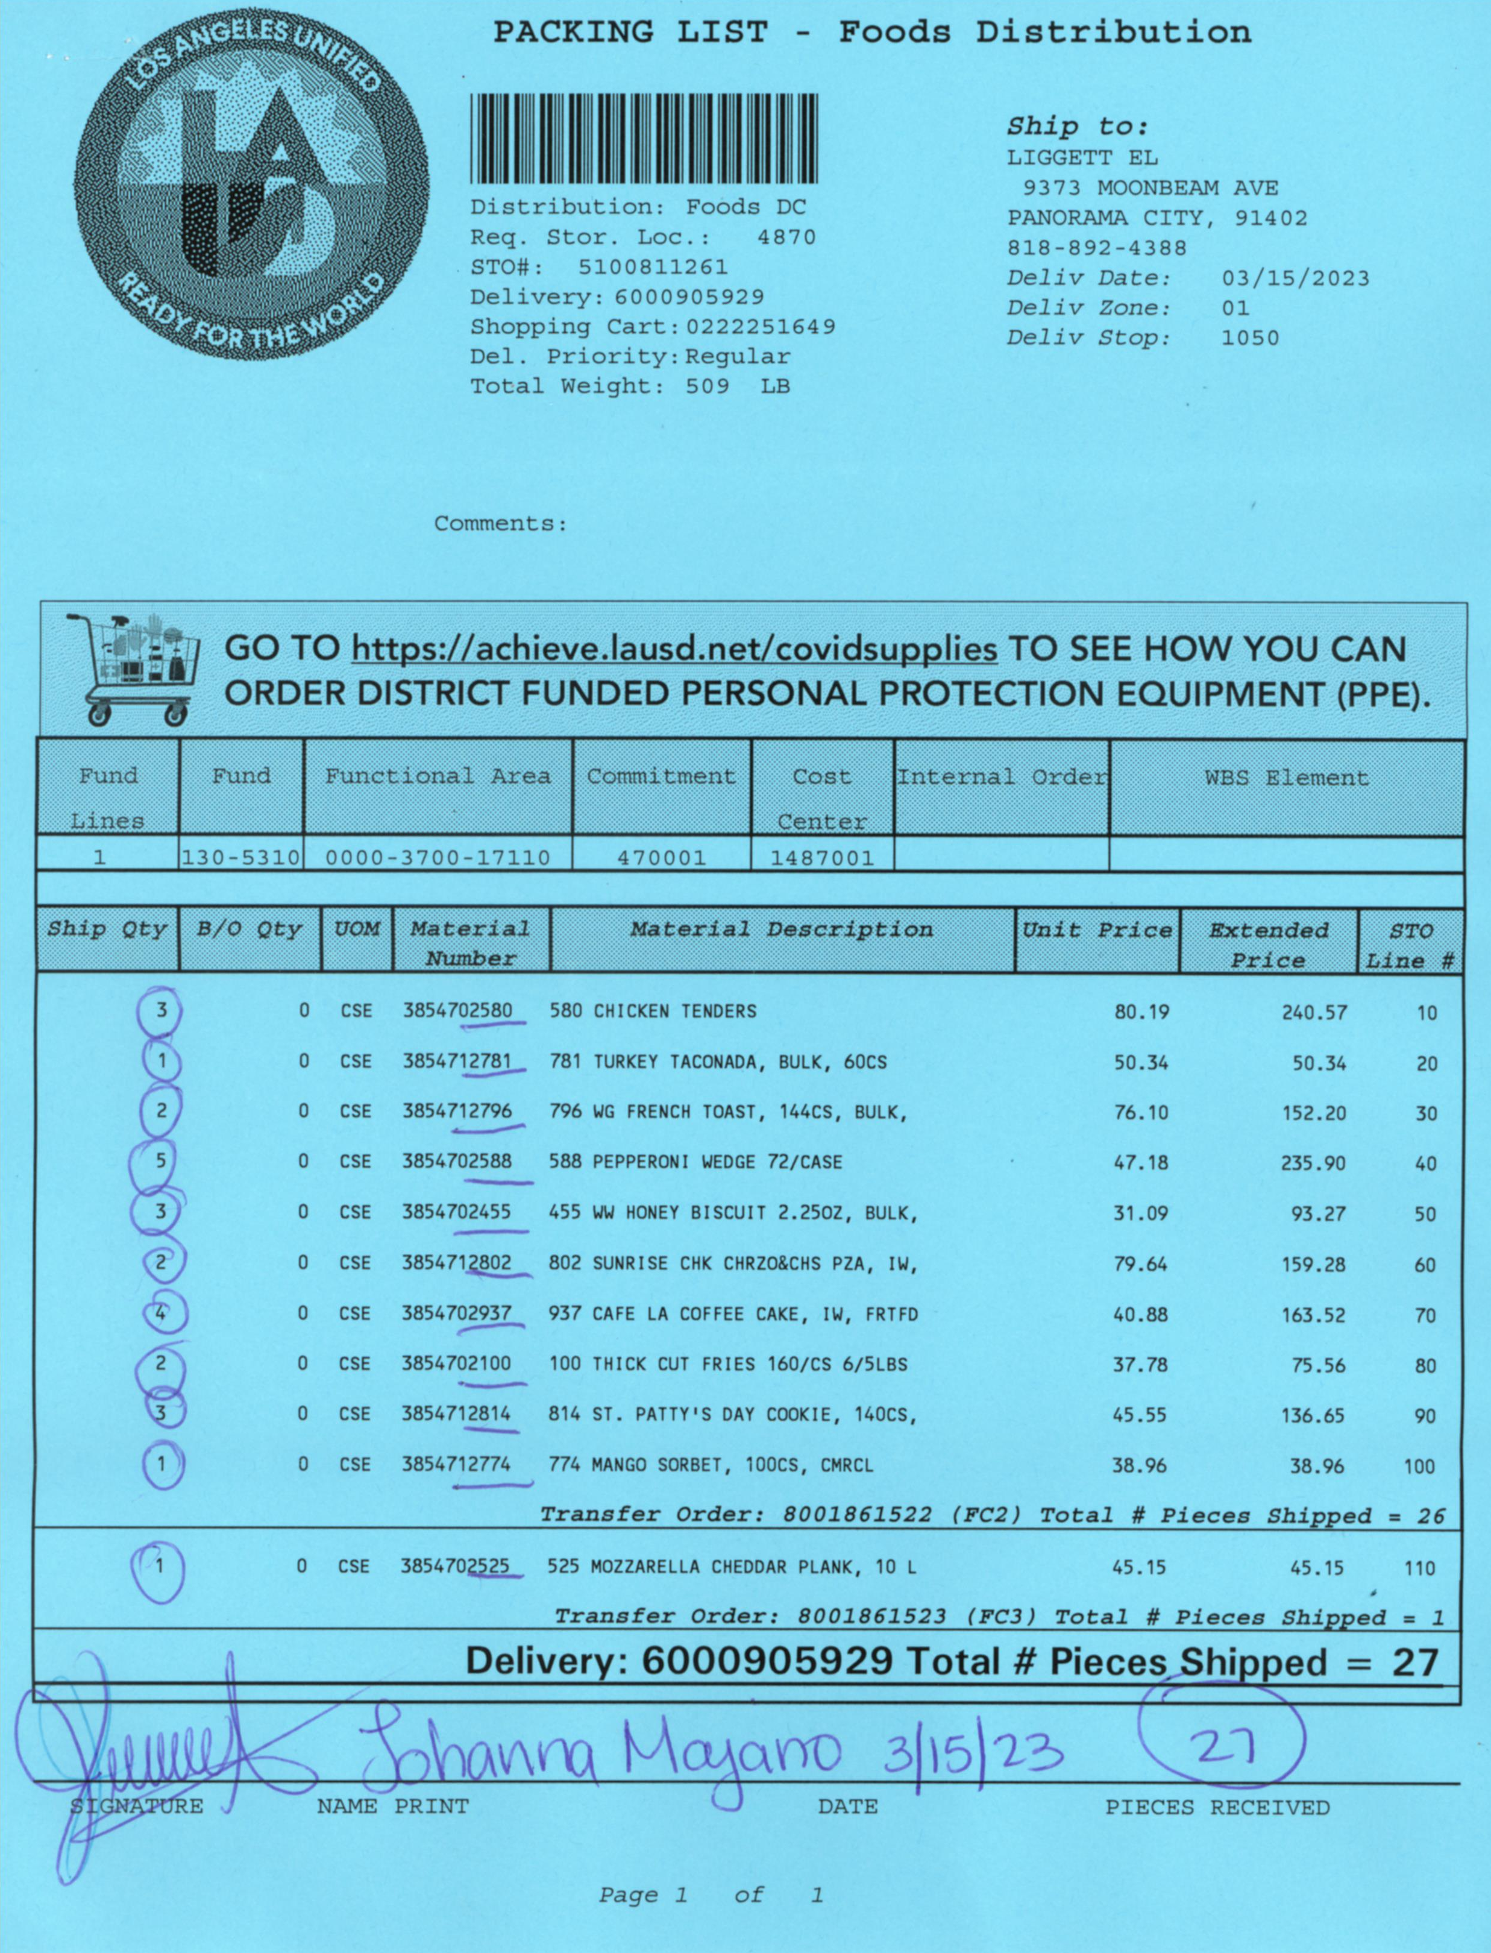
Receivers
&
Invoices
Driftwood
Grocery
&
Staples
Clearbrook Farms
Chemicals
Goldstar
Frozen

Slide 11
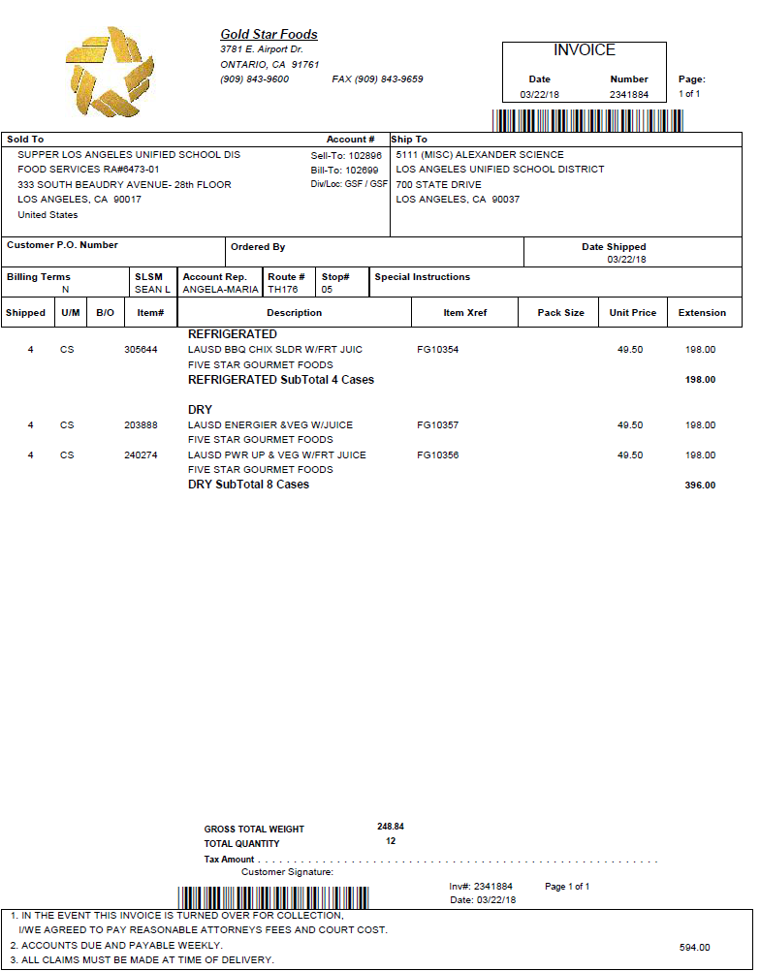
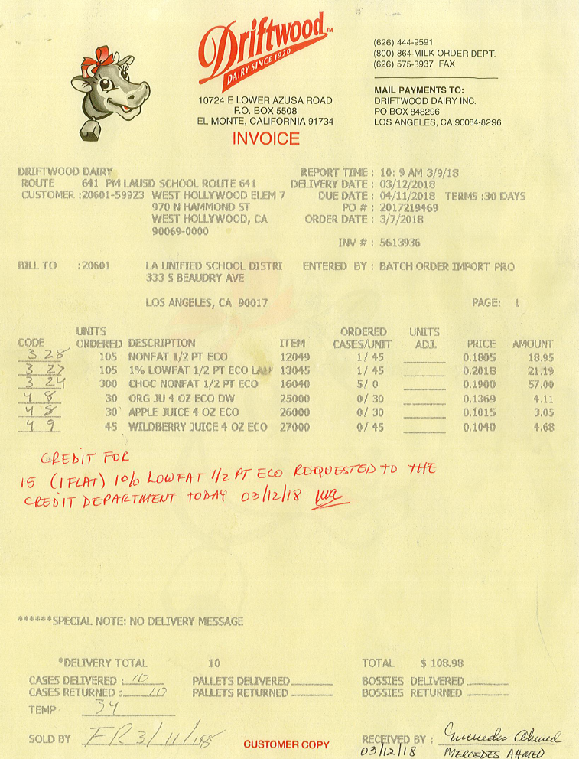
Receiver CMS Entry
  Enter receivers promptly in CMS. Use the correct:
  Invoice number
  Quantity received

Slide 12
Invoice Discrepancies
  If there is a discrepancy listed on the invoice, enter the correct amount received in CMS immediately.
  Do not count missing or damaged items
  Write a comment on the invoice and send a copy to Café Fiscal Support
  Request a credit memo, from the vendor, for rejected items or incomplete deliveries
    Follow up to ensure the credit is issued
  Review receiver report and the credit memo file
    Ensure vendors have been paid correctly

Slide 13
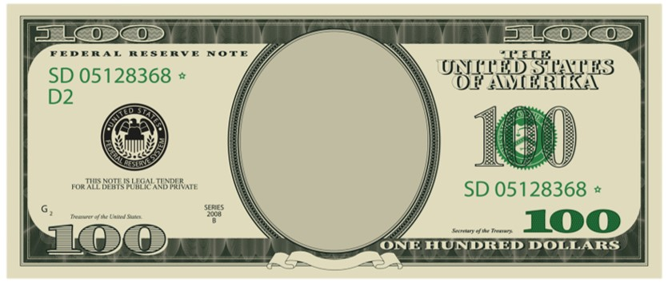
Cash/Sales Transactions

Slide 14
Students With No Co-pay - POS
  If a student has no cash for co-pay, you must select the “Charge” button.
    This will avoid cash shortages
    The amount of the co-pay will be charged to the student account

Slide 15
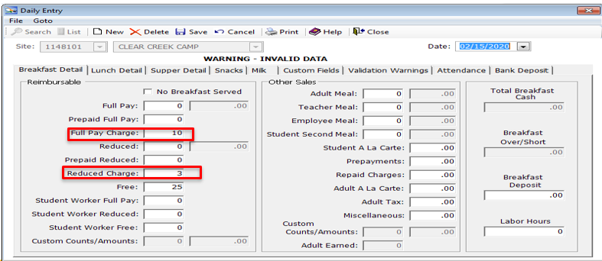
Students With No Co-pay No POS
  Pricing sites with no POS terminals. For students that have no co-pay: Use the Daily Entry Screen and click on:
    “Full Pay Charge” box for full price students
    “Reduced Charge” box for reduced price students

Slide 16











Cash Sales
  Standard Operating Procedure requires Food Services staff to post all sales into CMS immediately.
    Incorrect or unreported cash sales will result in a cash shortage or overage

Slide 17
Cash Deposits
Each day cash is received the FSM is responsible for preparing a deposit slip.
Deposit all cash collected daily
Sites with an approved waiver must deposit funds:
  Whenever collections reach $50
  The last day of each week
  The last school day of each calendar month
  No part of the deposit may be withheld from the bank deposit
Notes:
Tell:

Slide 18
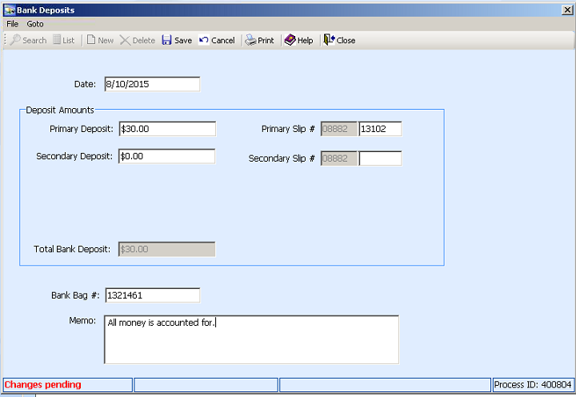
CMS Bank Deposit Memo Box
Enter the complete bank deposit slip number into CMS.
Ensure the cash collected equals the deposit slip amount.
Make notes of any banking inconsistencies in the “Memo” box, even if the cash variance is $0.01 over or under.
Indicate if the sale is an adult or student.
Terminal 2 was over $0.50.
Adult overpaid for a coffee.
“Total Posted” should equal “Bank Deposit.” If it does not:
Attempt to resolve the discrepancy first
An explanation is required when discrepancy cannot be resolved
Notes:
Tell: Depending on the day’s activities, It is mandatory to make notes of any banking inconsistencies in the bank deposit memo box. Even if the amount is one cent over or short. Always identify if the customer as an adult or student.

Slide 19
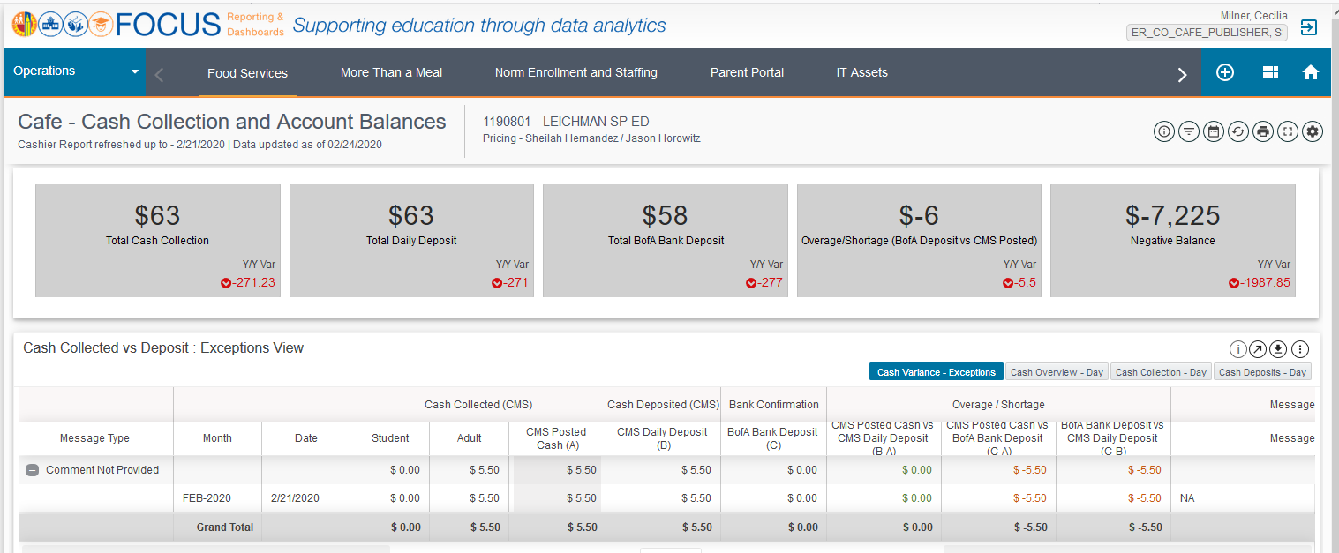
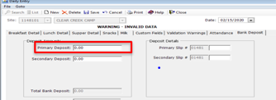
Focus Dashboard Review
  Each week, review the Focus Dashboard Cash Collection and Account Balances where cash overage/shortage is shown.
    Ensure the “Total B of A Deposit” box is equal to the CMS “Primary Deposit” box.
Notes:
Tell:.

Slide 20
Invoices
And
Cost Forms
Notes:
TELL:

Slide 21

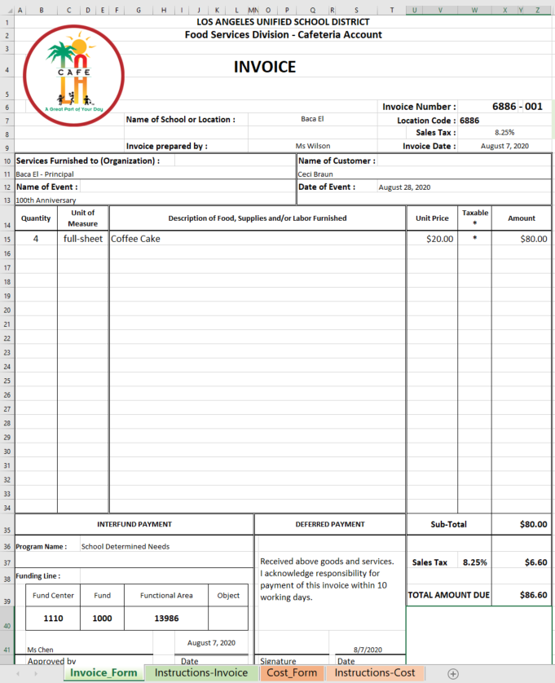
Special Function Invoice
Use the Excel template Special Cafeteria Invoice to document catering, special orders and other billings.
LAUSD Tax Rate are subject to change
City | Tax Rate
Cudahy | 10.250%
Gardena | 10.250%
Huntington Park | 10.250%
San Fernando | 10.000%
South Gate | 10.250%
All other areas | 9.500%
FSM will number the form using the four digit site ID, followed by a three digit number beginning with 001.
Each new invoice will be numbered sequentially (001,002,003, etc.)
When completing the form; keep in mind that sales tax is for adult sales only. Use the correct sales tax for your location.
Notes:
Tell:

Slide 22
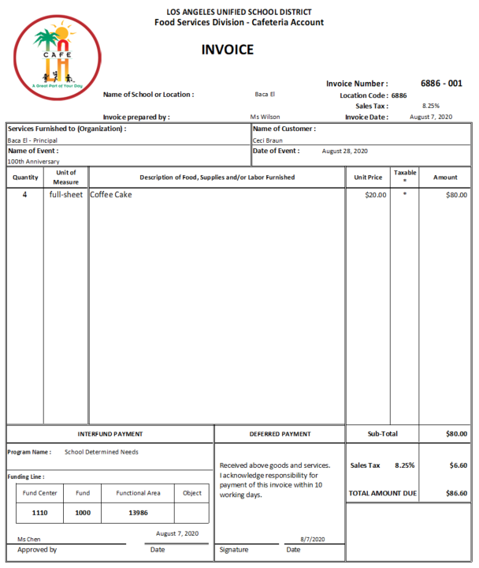
Special Function Cash/Check Payment
For invoices paid in cash or check, write on the invoice “Paid Cash” or “Paid Check.” Include the check number and date received.
PAID
Check # 3387
8-8-20
Notes:
Tell:

Slide 23
Interfund Payments
Send a clear, readable, copy of the invoice to Café Fiscal Support, 26th Floor, Beaudry, via school mail.
For Interfund payments, the complete funding line must be written on the invoice.
Customer must sign the invoice.
C. Braun

Slide 24
Special Function Invoice Collections
Include collections from the Special Function Invoice within the daily deposit. In the CMS bank deposit memo box enter:
Invoice number
Invoice amount
Check number (if check received for payment)
Funding line number (when applicable)
Notes:
Tell: For Special Function Invoices the school site should enter in the bank deposit memo box the invoice number, amount, check number (if a check was received) and specify if sale is for student or adult. Send the yellow copy to Café Fiscal Support. Do not bill more than one month on one invoice.

Slide 25
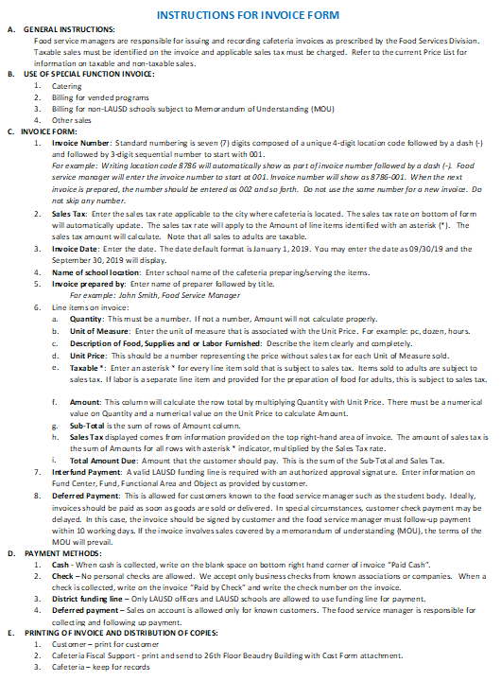
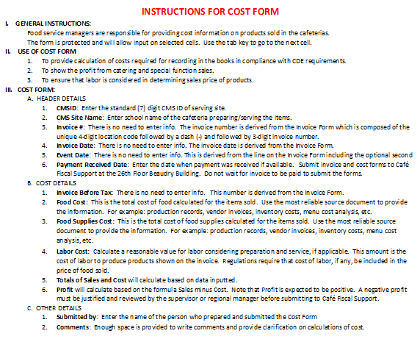
Special Function Invoice Instructions
Click on the “Instructions – Invoice” tab at the bottom of the page to view the instructions for completing the invoice.
Click on the “Instructions – Cost” tab at the bottom of the page to view the instructions for completing the cost page.
Follow the instructions on the Cafeteria Invoice Excel template, for details on how to complete the invoice and cost forms.
Notes:
Tell:

Slide 26
Cafeteria Account Refund Requests
Notes:
TELL:

Slide 27
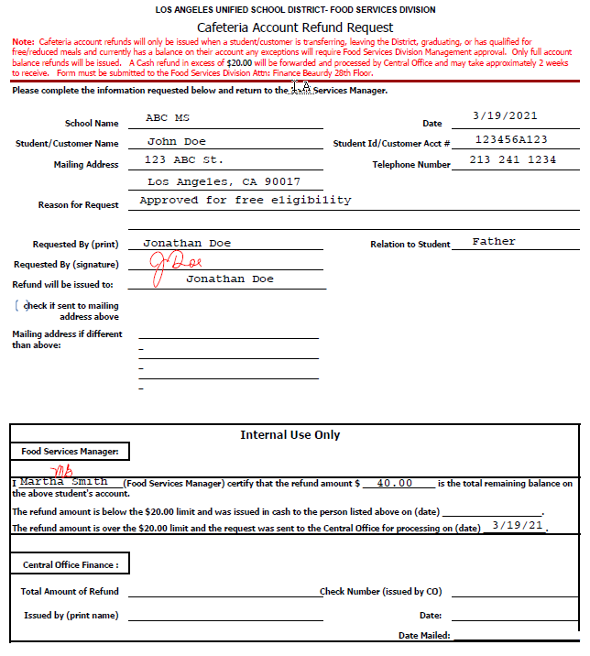
Cafeteria Account Refund Request
Please complete the Food Services Manager portion at the bottom of the form and submit to Café Fiscal Support
26th Floor, Beaudry Building.
The “Cafeteria Account Refund Request” is located on the Café LA website, Training and Resources page in the Financial section.
Notes:
Tell:

Slide 28
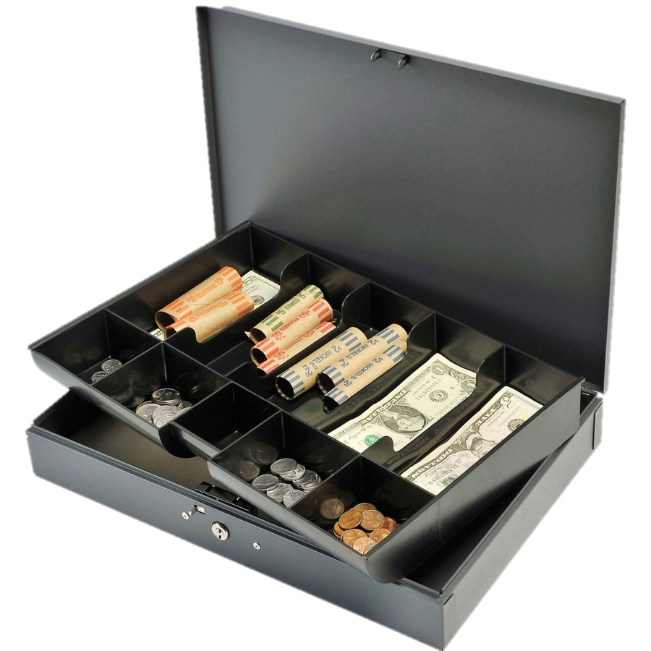
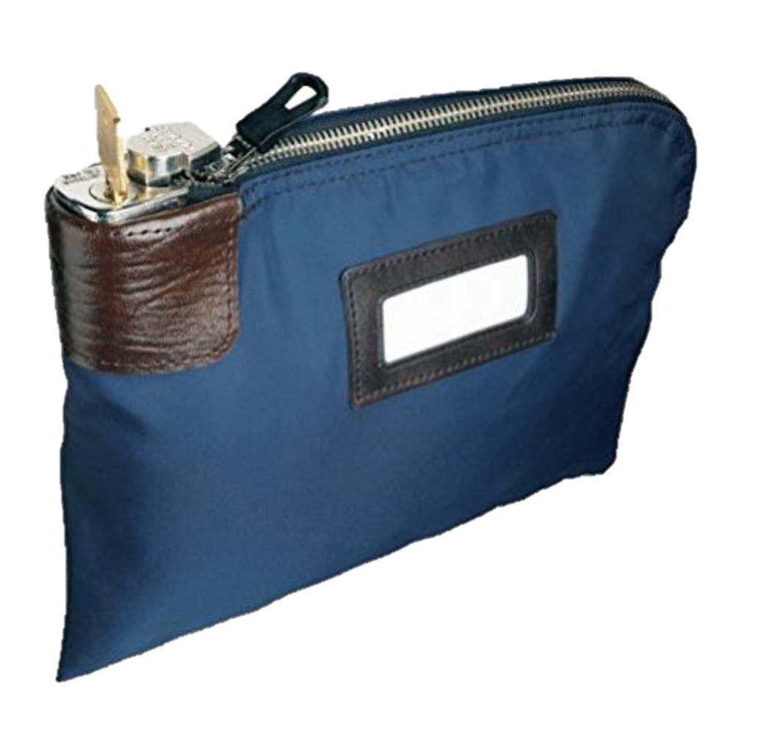
Change Funds
Notes:
TELL:

Slide 29
Change Fund Forms
  Always obtain approval from Café Fiscal before making changes to the change fund. Use the applicable form.
“Increase Change Fund” Do not use collections to add to the change fund. A check will be issued by Café Fiscal in the amount approved.
“Decrease Change Fund” Deposit the approved amount and make a note of the amount in the bank deposit memo box.
“Turnover of Change Fund” is completed when the physical hand off of the fund from the outgoing manager to the incoming manager takes place.
Notes:
TELL: Changes occur throughout the year employees moving from one location to another, new hires or long term change of assignments. It is imperative that when changes occur the Change Fund Forms at the site are current. To establish a change fund use form new, to increase the already established change fund use the increase, to decrease the established change fund decrease, if you are leaving your current site and were the steward complete the turnover form. Each one of these forms can be found under the training and resources tab, scroll down to Financial Section and select the desired form. Everything pertaining to banking can be found in this section.

Slide 30
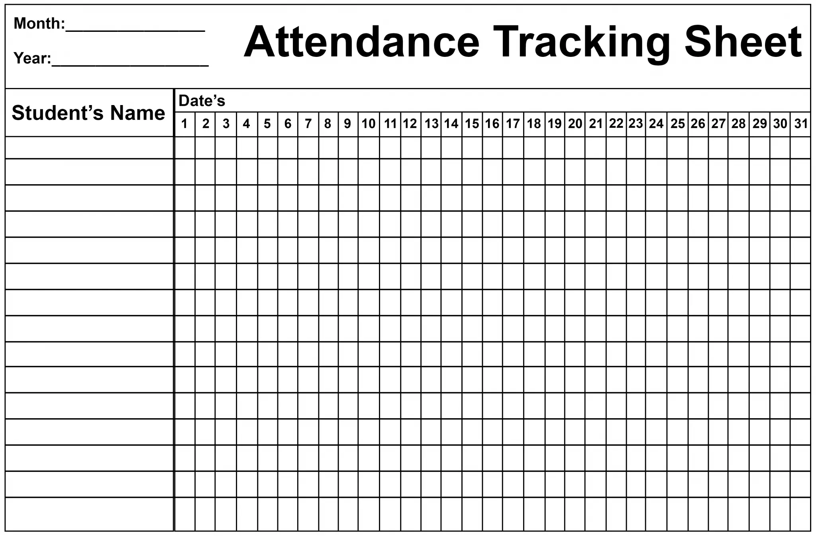

Attendance
Enrollment
Variances
Notes:
TELL:

Slide 31
Edit Check Report
  Check the meal counts in the “Edit Check” report against the schools enrollment and attendance each day.
    If meal count is low due to minimum day, put a note in the bank deposit memo box
    An “Out of Compliance” issue is caused when the meal count is higher than the “Daily Attendance Factor”
      Note the reason in the bank deposit memo box
In addition, on the Daily Entry screen; check the “No Meals Served” box for breakfast, lunch or supper that have no meals served for the day. This will help in reducing missing meal counts.
Notes:
Tell:.

Slide 32
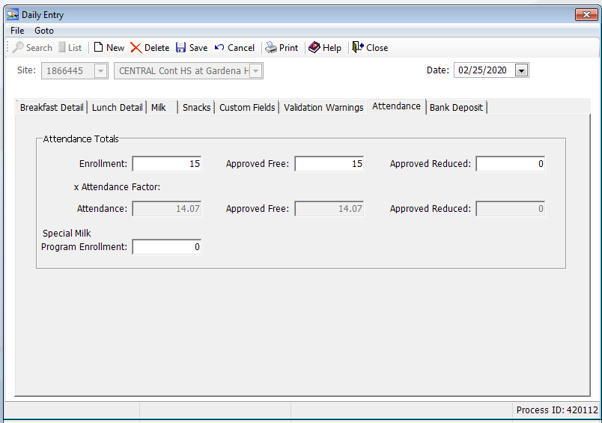
CMS Daily Entry Attendance Tab
  In the CMS Daily Entry Attendance tab, enter the correct enrollment for non-POS sites (offsites) and pricing sites every day.
Enter enrollment by “approved Free” and Approved Reduced” students
This will prevent out of compliance issues
Notes:
Tell:.

Slide 33
Refer to your Orientation Packet for a complete list of important reminders from Café Fiscal.
Thank you!
Notes:
Last page:
“Questions”, centered, calibri black, 44 font
“Thank You”, centered, calibri black, 40 font
“LAUSD Food Services Division~Nourishing Children to Achieve Excellence” Calibri, 18 font, Justified left

